Slide 1
Estimation using instrumental variables
Neil M Davies
MRC Integrative Epidemiology Unit
Bristol Medical School, University of Bristol
K.G. Jebsen Center for Genetic Epidemiology, Department of Public Health and Nursing, NTNU,
20th November 2020
All the materials are available here:
https://github.com/nmdavies/causal_inf_course/

Slide 2
Overview
1. Introduction to causal inference
2. Principals of instrumental variable analysis
3. Estimation with instrumental variables
4. Interpretation and reporting of instrumental variable analyses

Slide 3
Objectives
Know about and be able to use the following instrumental variable estimators:
Instrument definition and selection
Instrument-outcome associations
Instrumental variable bounds
Continuous outcomes
Binary outcomes
Causal odds-ratio
Causal risk-ratio
Survival outcomes
Two-sample estimators
Multivariable instrumental variables estimators
Covariates

Slide 4
1. Defining instruments
Instruments can be defined in many ways
For example
Physicians’ preference:
Prescription issued to prior patient
A count of prescription issued to 7 prior patients
Proportion of prescriptions issued to prior patients
Geometric mean
Squared number of prior prescriptions
……
Different definitions will have different properties in terms of bias and precision/strength

Slide 5
A DAG for Rassen et al. (2009)
Unmeasured confounders
(Exposure)
Prescribed typical or atypical anti-psychotic
(Instrument)
Physicians’ preferences
(Outcomes)
Mortality
Hypothesis: Does prescribing atypical vs typical anti-psychotic medication affect mortality?

Slide 6
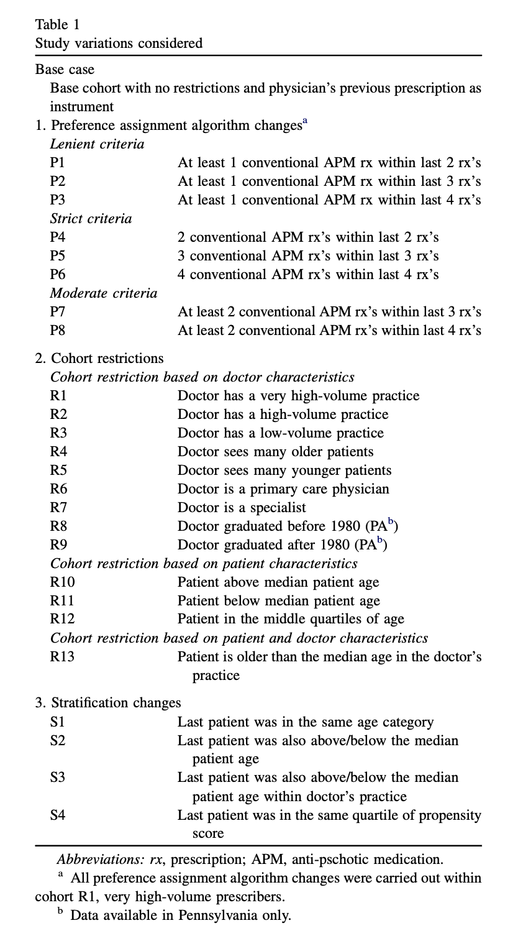
1. Defining instruments
Rassen et al. (2009) compared 25 study designs
Compared typical to atypical anti-psychotics
Varied
Definition for defining preference
Cohort inclusion criteria
Sample stratification criteria
Resulted in substantial differences in power

Slide 7
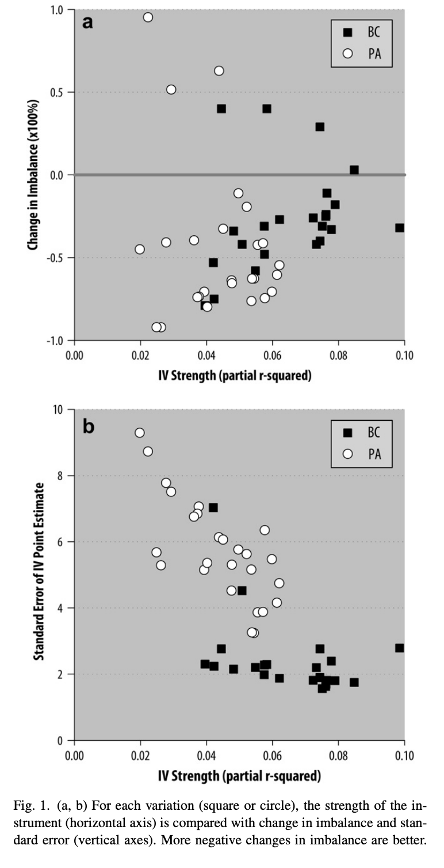
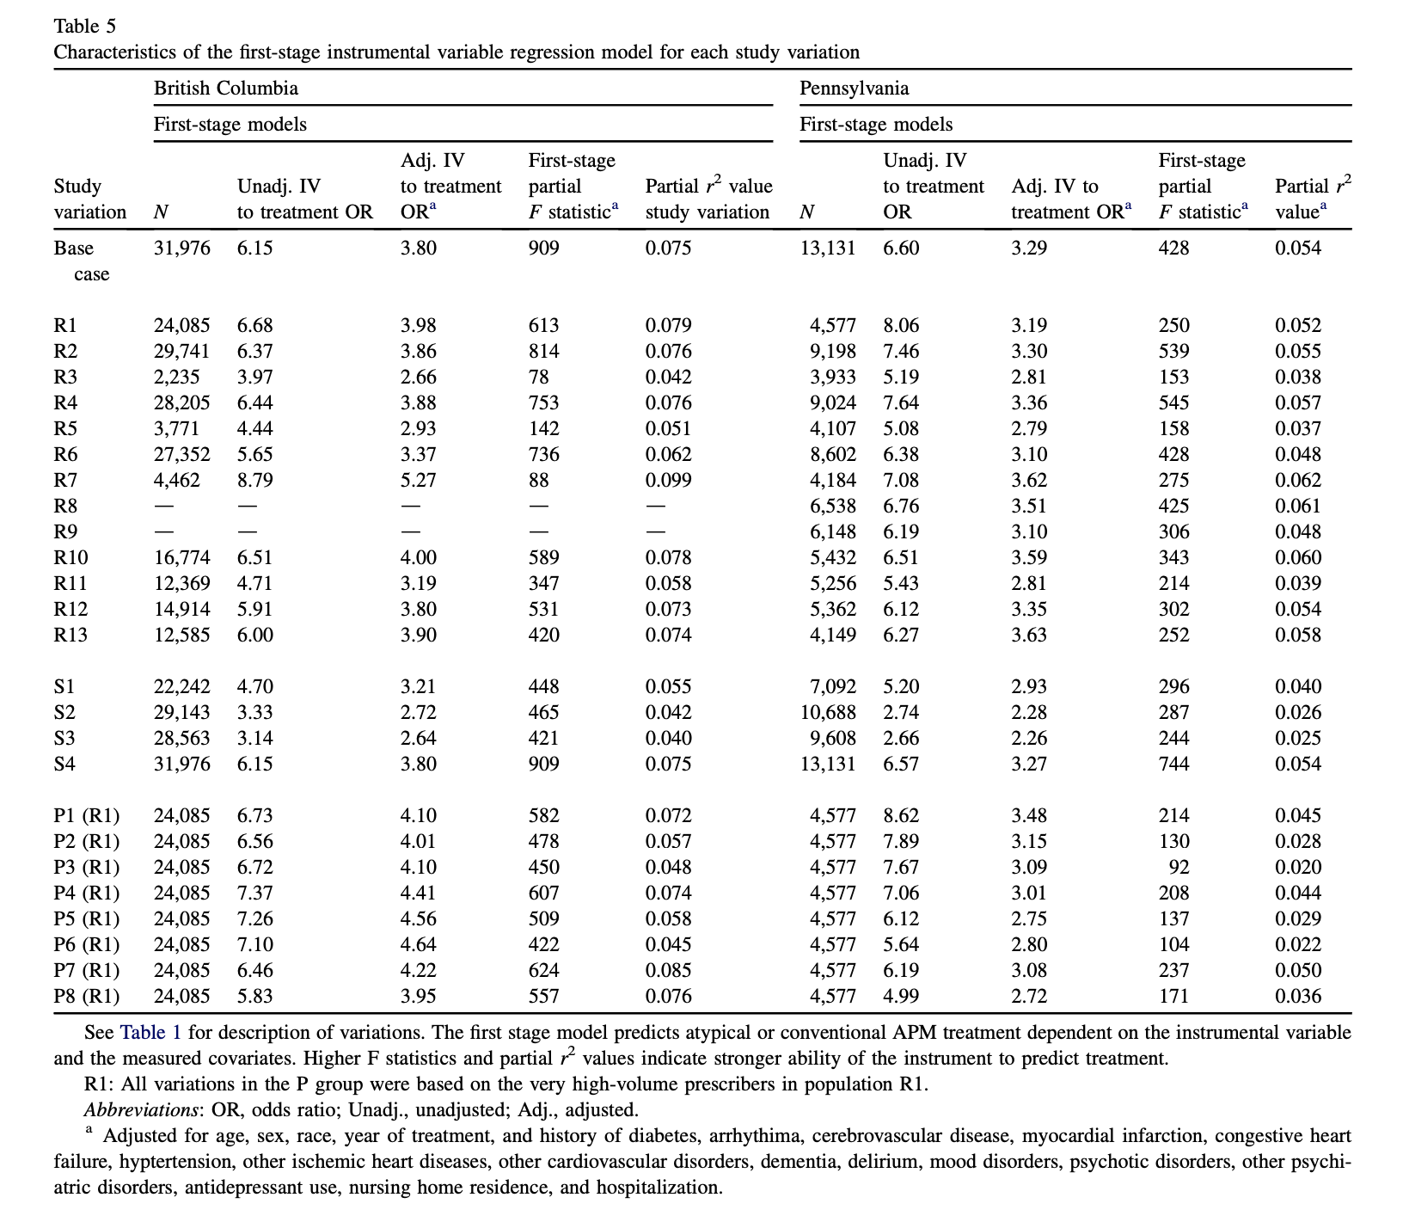

Slide 8
1. Defining instruments
Definitions make a big difference
Including more information normally improves strength of instruments
Using a more focused definition of index date
E.g. comparing two similar drugs, or similar groups of patients.
Danger of overfitting
Prespecify if possible
Split the samples to develop and define instrument
Do not iterate across 1000s of definitions and choose the “best” in your data
This would result in over-fitting, bias, and overly precise results
More methodological work needed on this……

Slide 9
2. Instrument-outcome associations
The simplest IV estimator is the instrument-outcome association
Sometimes referred to as the “reduced form” estimator
Advantages
Simple, requires fewest assumptions
Similar power to reject the null as other approaches
Disadvantages
Wrong scale
Not interpretable
Limited use for clinical decisions or publication.
Confounders
Instrument
Exposure
Outcome

Slide 10
3. Instrumental variable bounds
Recall the 3 assumptions defining an instrument
Instrument associates with the exposure (relevance)
There are no unmeasured confounders of the instrument-outcome association (independence)
The instrument has no effects on the outcome except via the exposure (the exclusion restriction)
Alone these assumptions allow the bounds of the causal effect to be identified
The bounds are easy to estimate.
Stata/R package bpbounds and R package ivtools (ivbounds), also see worked example using bpbounds.
Palmer T, Ramsahai R, Didelez V, et al. Nonparametric bounds for the causal effect in a binary instrumental variable model. The Stata Journal
Swanson SA, Hernán MA, Miller M, et al. Partial Identification of the Average Treatment Effect Using Instrumental Variables: Review of Methods for Binary Instruments, Treatments, and Outcomes. Journal of the American Statistical Association 2018;113:933–47. doi:10.1080/01621459.2018.1434530

Slide 11
3. Instrumental variable bounds
Advantages
Requires weak assumptions
Can be easily estimated using packages
Disadvantages
Power is minimal & is rarely informative
Requires binary instrument and exposure
Slightly painful to calculate (just use a package)
Makes most readers lose interest!
Summary – only use if you are either a) a methodologist, or b) Reviewer 2 asks for it – use a package and put in the supplement.
I am not aware of a compelling practical application of IV bounds.

Slide 12
4. Continuous outcomes
Two stage least squares
Estimates a linear model
Reports mean difference in outcome per unit change in exposure
Same scale as a conventional linear model
In Stata
ivreg2
In R
ivpack

Slide 13
Syntax
ivreg2 outcome (exposure = instrument(s)) , ro first endog(exposure) options
Syntax similar to reg

Slide 14
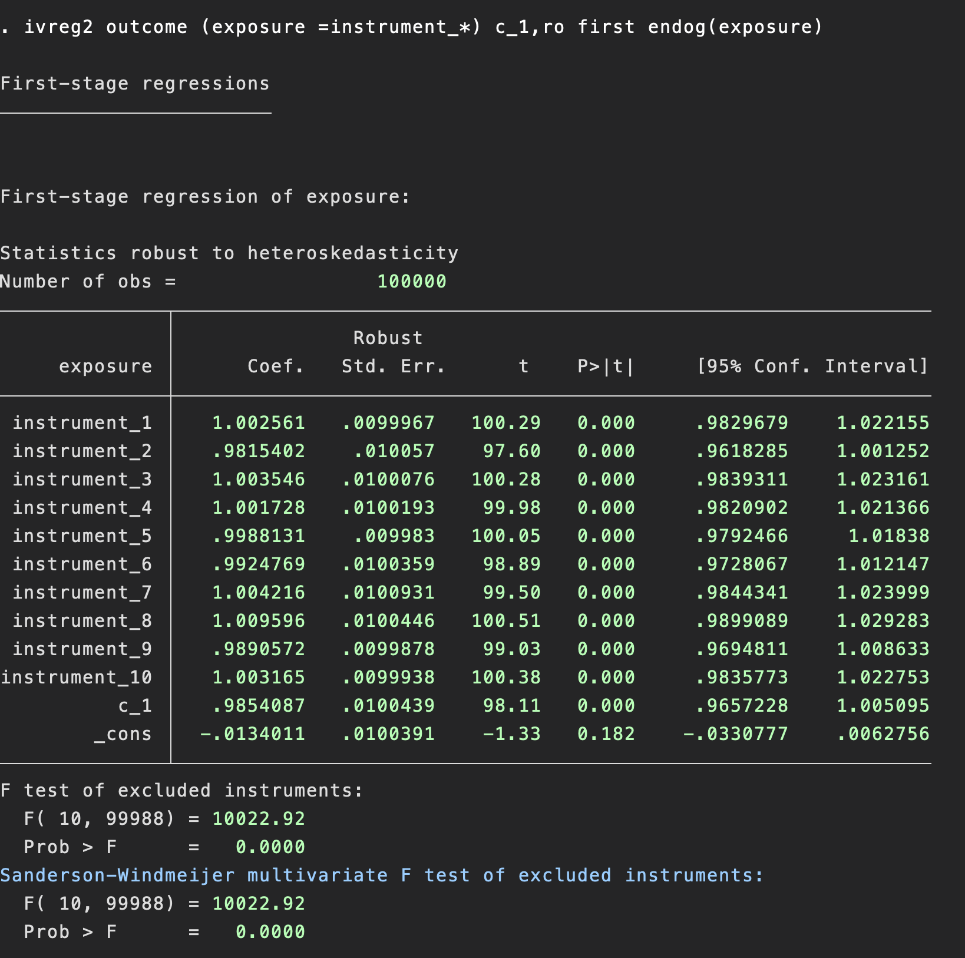
Option first gives the following output
Associations of the instrument and the exposure
Sanderson-Windmeijer F-test relevant for multiple instruments

Slide 15
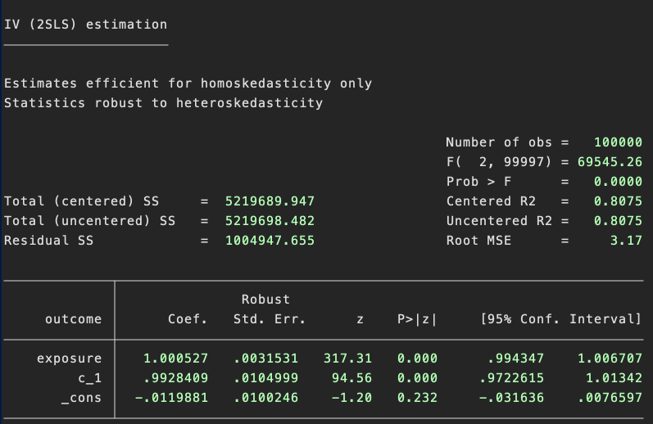
Estimated effect of the exposure on the outcome on the mean difference scale

Slide 16
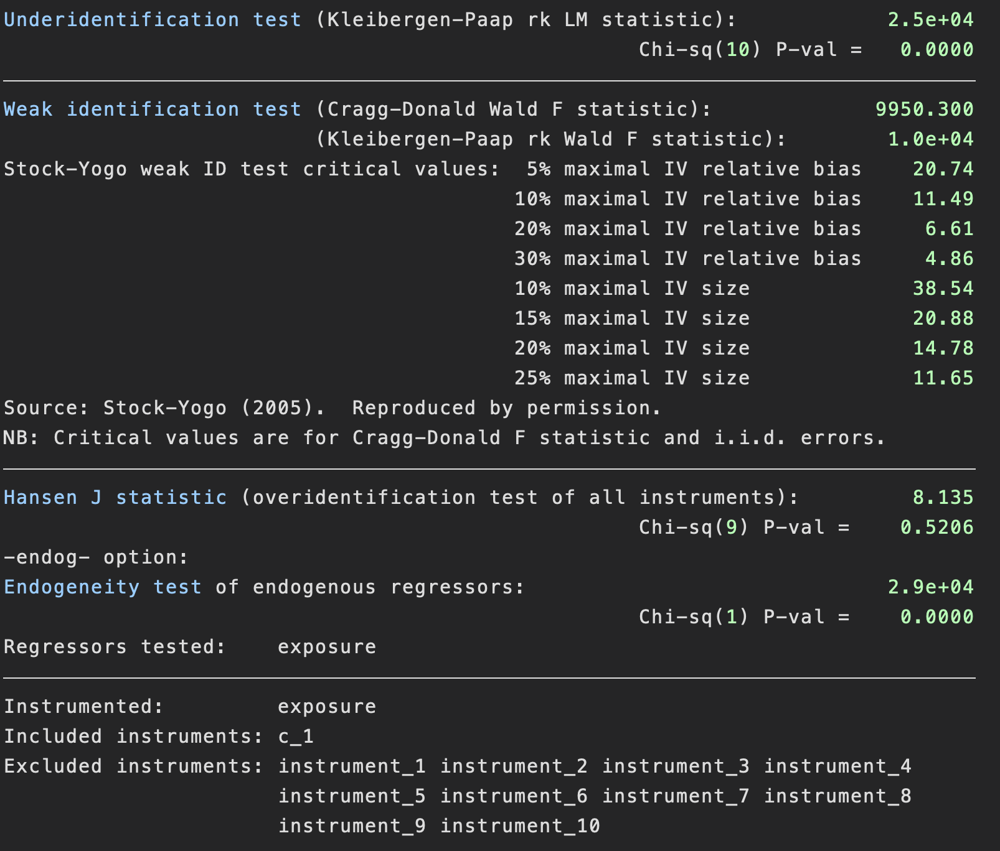
Under identification test, a test of the instrument strength (i.e. of the Z-X association)
Weak instrument tests, indicates the thresholds for the F-statistic for different amounts of weak instrument bias. If your F-stat (top number) is bigger than the thresholds, then weak instrument and many weak instrument bias is unlikely.
Hansen J stat - test of heterogeneity of effects across instruments, requires at least 2 IVs. Null hypothesis: no heterogeneity.
Endogeneity (Hausman) test
Null hypothesis: no difference between OLS and IV estimates.

Slide 17
4. Continuous outcomes
Advantages
Easily interpretable
Easy to estimate
Disadvantages
Requires stronger assumptions than the IV bounds
Many outcomes of interest are binary
Some audience may expect a odds-ratio or risk ratio
Will discuss point identifying assumptions in and interpretation in lecture 4.

Slide 18
5. Binary outcomes
Binary outcomes can be estimated using structural mean models (SMM)
Causal risk differences using additive SMM
Causal odds-ratios using logistic SMM
Causal risk-ratios using multiplicative SMM
Stata and R code is available
Warning – code is pretty rough
Logistic estimator is not well behaved
Clarke; PS, Palmer; TM, Windmeijer F. Estimating structural mean models with multiple instrumental variables using the generalised method of moments. Statistical Science Published Online First: Forthcoming.http://EconPapers.repec.org/RePEc:yor:hectdg:12/23

Slide 19
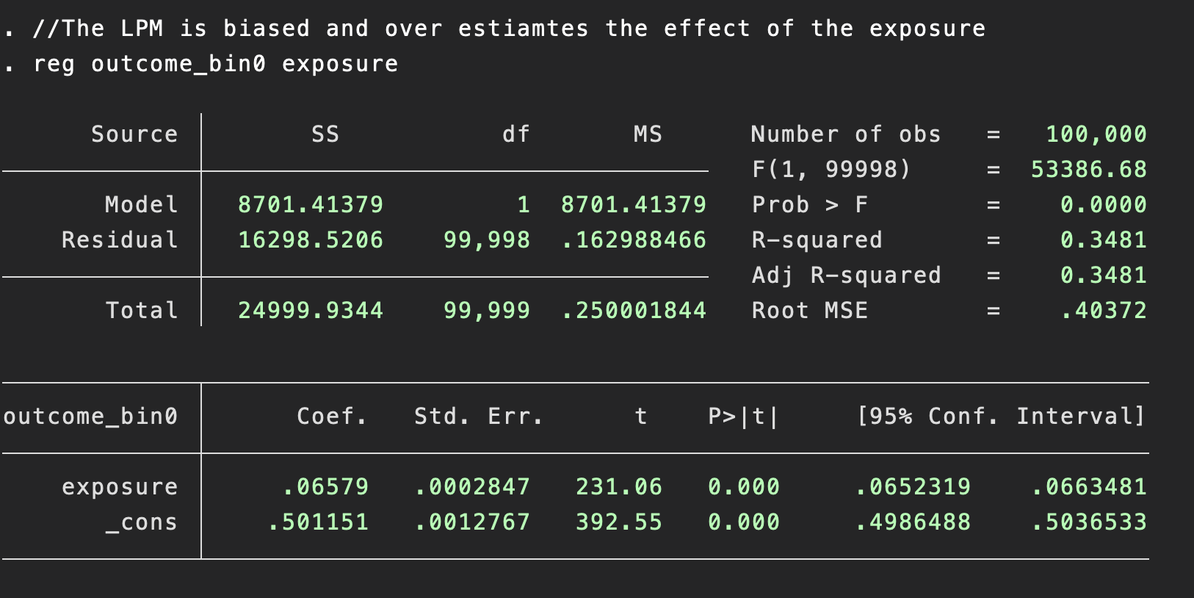
Linear probability model
We can generate a binary outcome via the logistic function
gen outcome_bin0=rbinomial(1,1/(1 + exp(-outcome)))
Using similar parameters to the simulations above results in a true risk difference of 1.88 per 100.

Slide 20
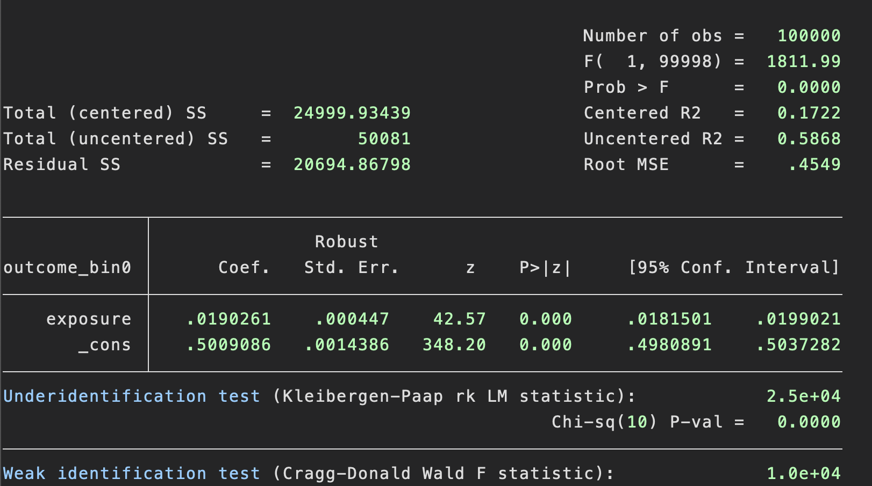
Additive structural mean model (ivreg2)
Whereas the additive structural mean model estimated by ivreg2 is consistent with the true values
Estimates the risk difference
Must use robust standard errors

Slide 21
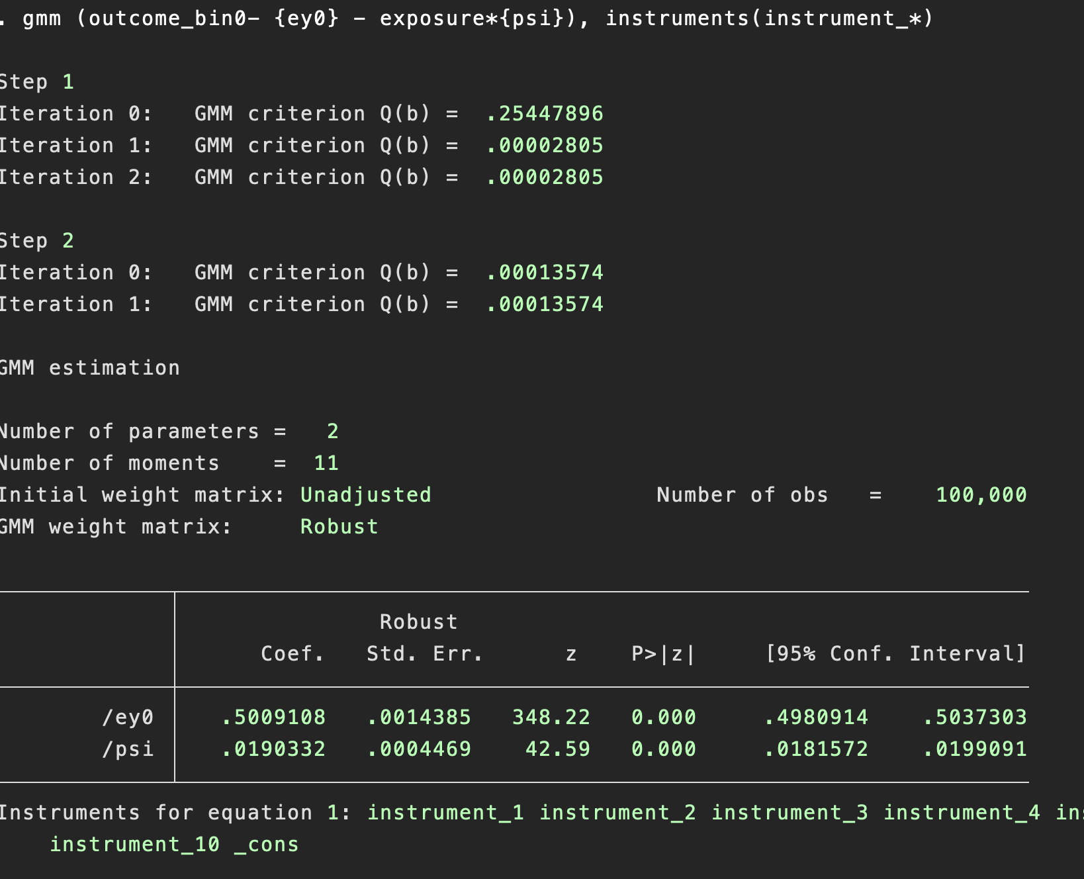
Additive structural mean models (SMM): generalized method of moments (GMM)
Alternative method of estimating risk differences using the additive SMM
No advantages compared to ivreg2
Just more complicated.
Why show you this?
We can use GMM to estimate causal odds-ratios and causal risk ratios which is not possible with conventional linear models or ivreg2.

Slide 22
Two-stage residual inclusion (2SRI) estimator
Estimate first stage instrument-exposure association
Estimate second stage non-linear model including
Residual from first stage
Predicted exposure from first stage
Fix standard errors
Bootstrapping
Generalized method of moments

Slide 23
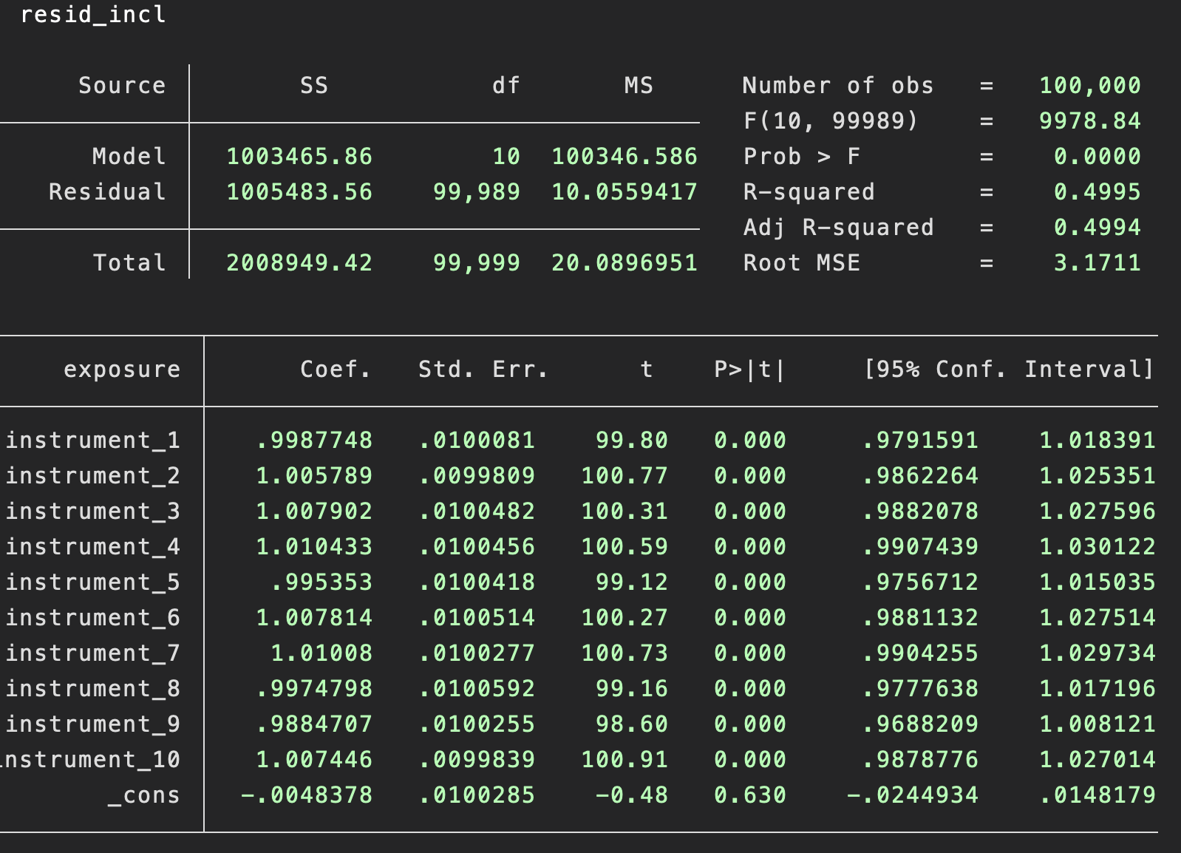
Two-stage residual inclusion (2SRI) estimator
Standard linear first stage
Predict exposure and residuals using predict
Estimate association with the outcome using logistic models

Slide 24
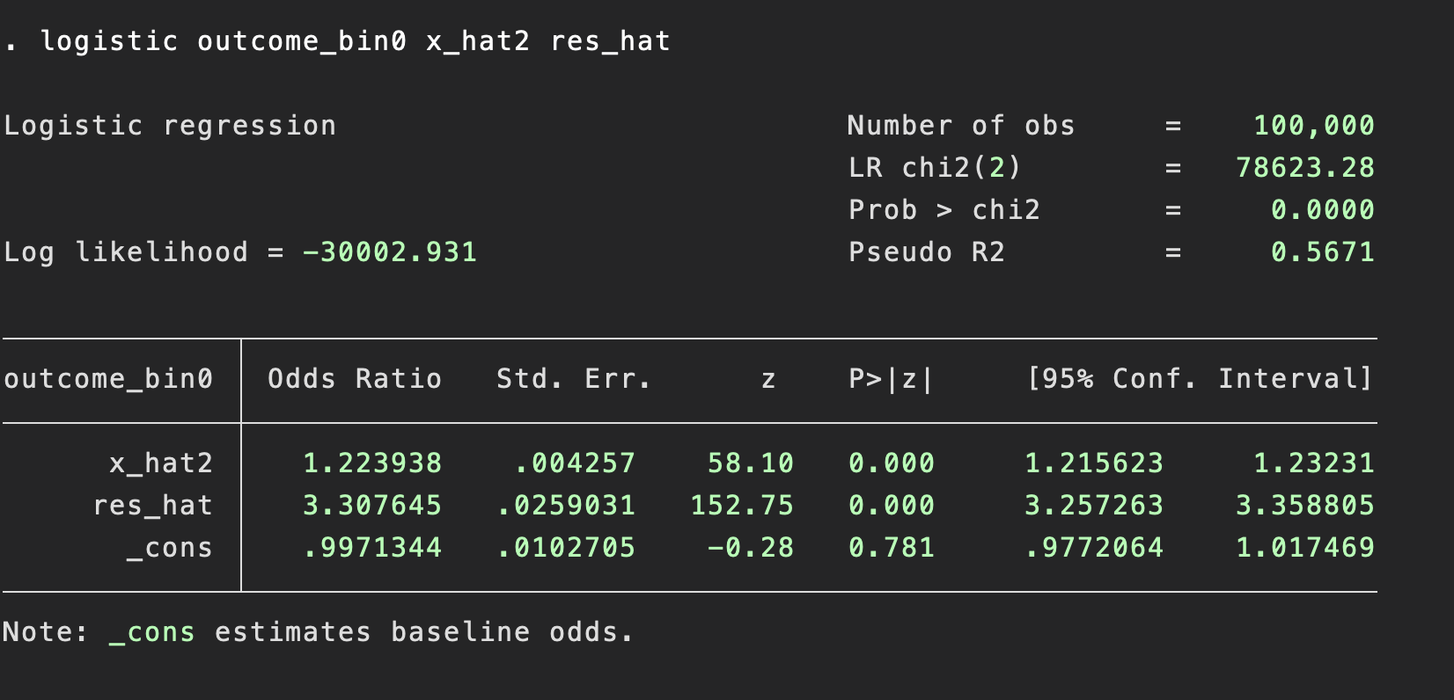
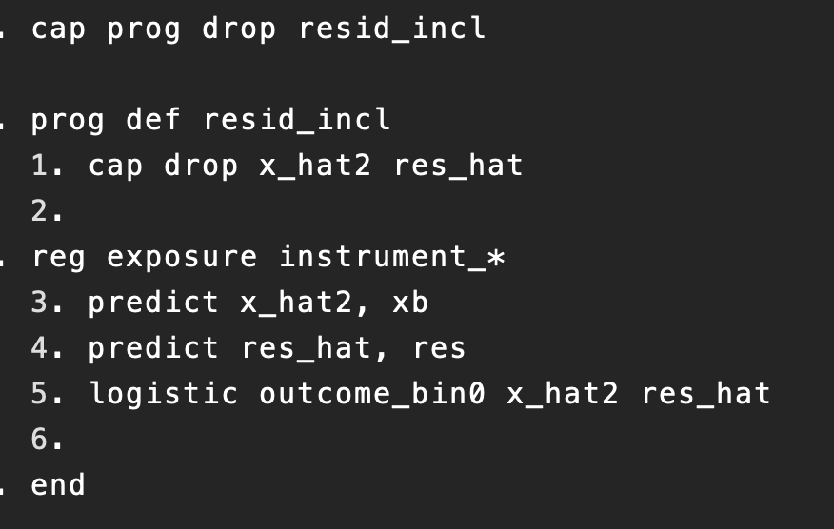
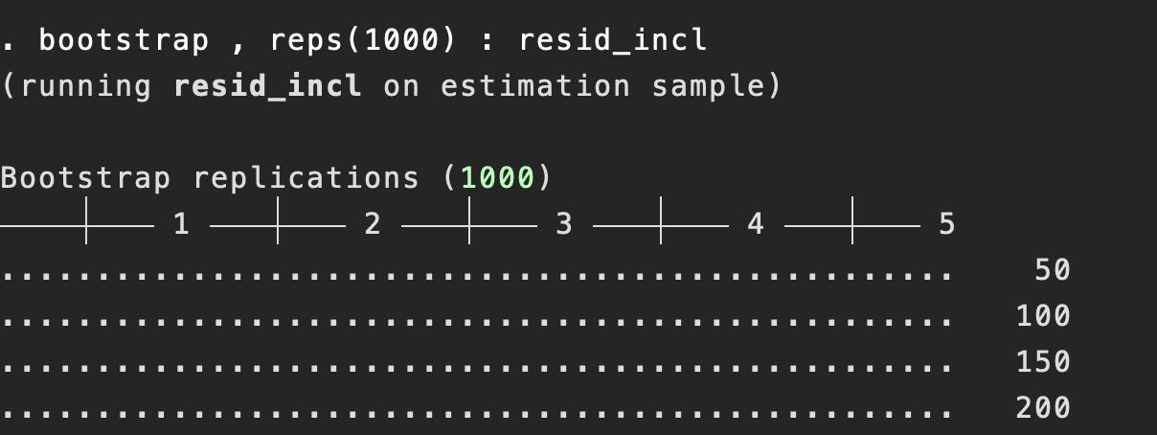
Two-stage residual inclusion (2SRI) estimator
Estimates a causal odds-ratio
However does not account for the estimation error in the first stage
Can use bootstrapping to get the correct standard errors

Slide 25
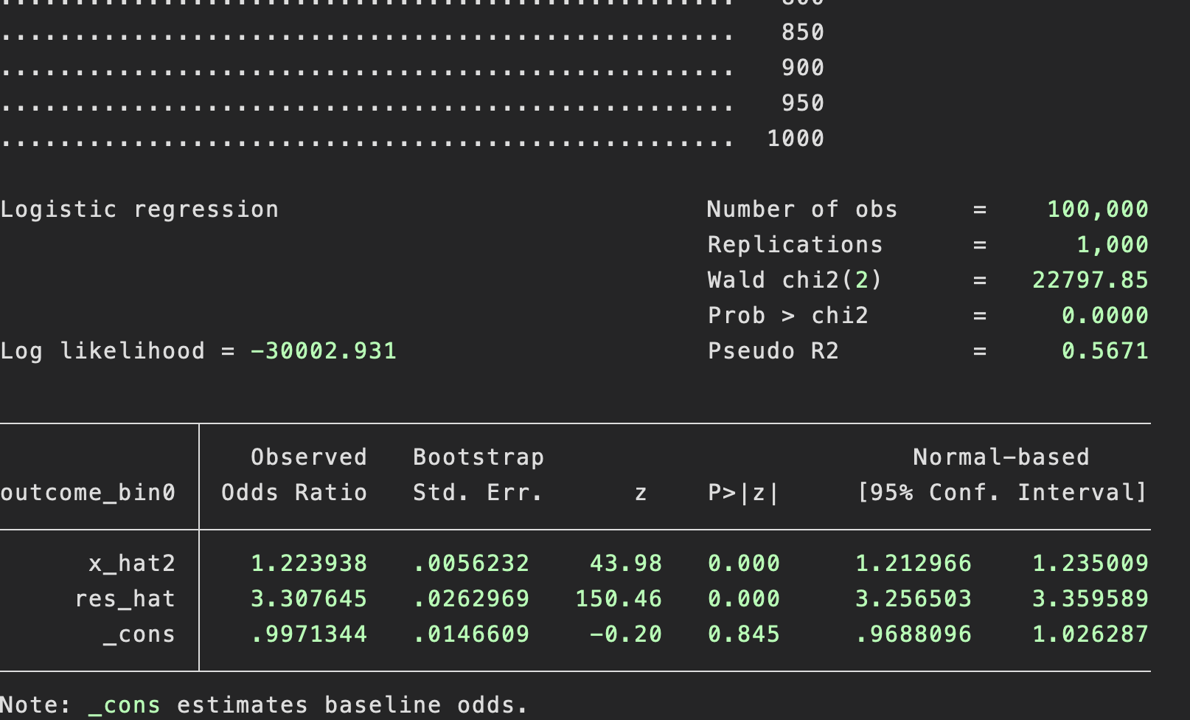
Two-stage residual inclusion (2SRI) estimator
Standard error increased from 0.0043 to 0.0056 i.e. increased by 32%
Computationally intensive
Simple

Slide 26
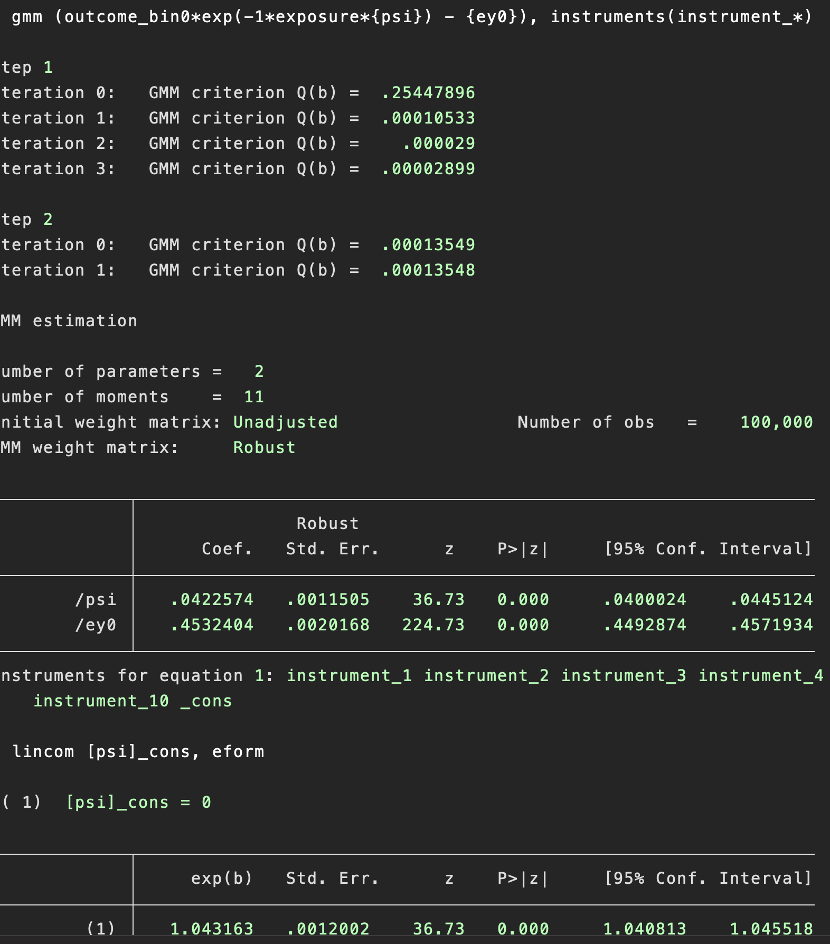
Multiplicative SMM using GMM
SMM for the causal risk ratio
The parameter of interest here is psi
psi=ln(causal risk ratio)
True value of the risk ratio=1.0376
Allows the causal risk ratio to be estimated.

Slide 27
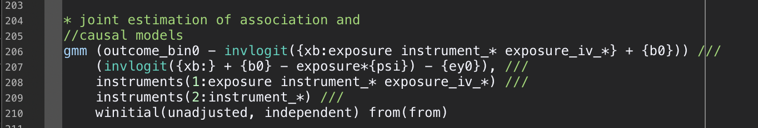
Logistic SMM using GMM for causal odds-ratios
Syntax is:
The True value of the causal odds-ratio is 1.078

Slide 28
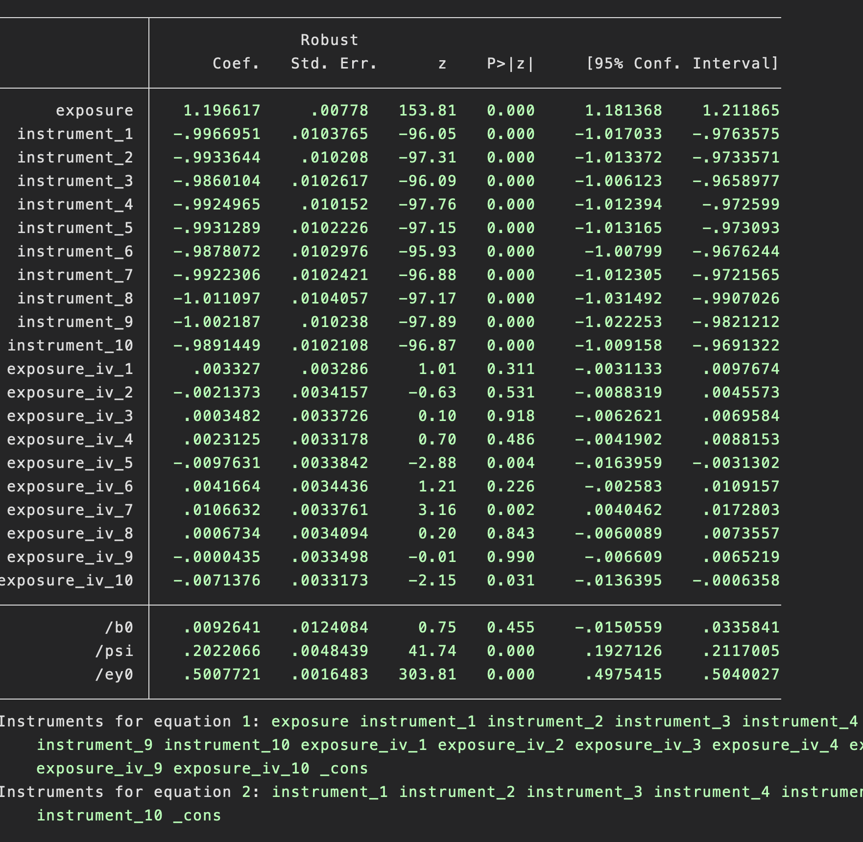
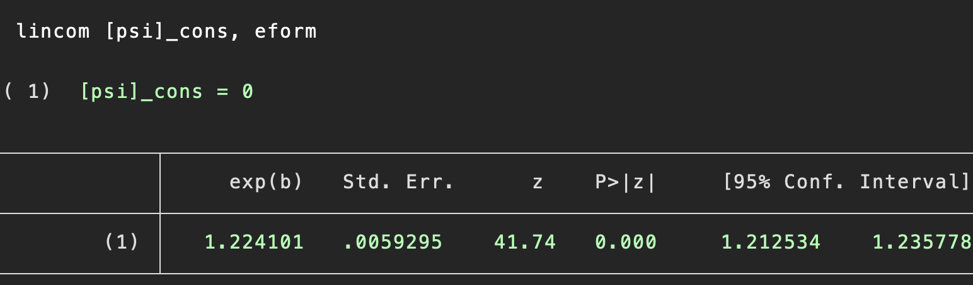
Logistic SMM using GMM for causal odds-ratios
Causal estimate given by the parameter psi
Which implies a causal odds-ratio of 1.22
Advantages
Can estimates the causal odds ratio
Should have correct coverage
Disadvantages
Complex
Does not always converge

Slide 29

6. Survival outcomes
Possible to estimate causal hazard ratios using instrumental variables
See published papers
Unclear how well developed and user-friendly packages are
Also see:
Tchetgen Tchetgen EJ, Walter S, Vansteelandt S, et al. Instrumental variable estimation in a survival context. Epidemiology 2015;26:402–10. doi:10.1097/EDE.0000000000000262

Slide 30
7. Two-sample estimators
The instrument-exposure and instrument-outcome associations can be estimated in separate datasets.
This is known as two-sample instrumental variable estimators (2SIV)
Can be highly efficient
E.g. if the exposure is very expensive to measure (metabolite or epigenetics)
Assumes that the instrument-exposure association is the same in the two samples
If samples entirely independent then can use manual two stage least squares.

Slide 31
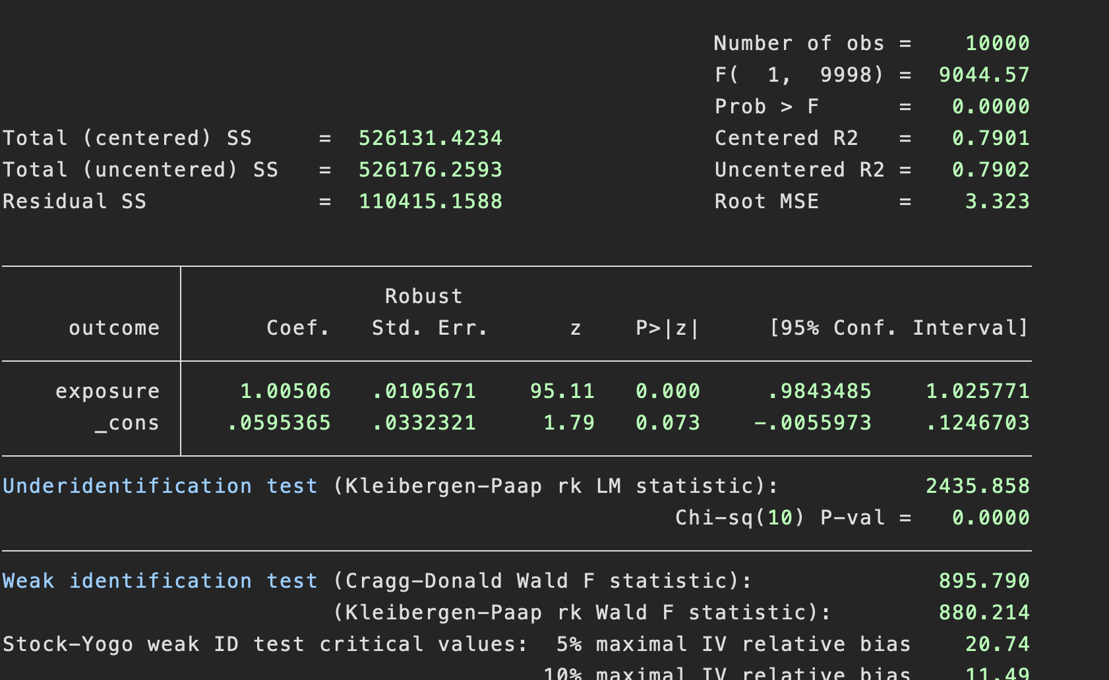
7. Two-sample estimators
100000 observations
Exposure measured in 10000
If we restrict to the 10% with exposure data we get the following:
SE=0.0106

Slide 32
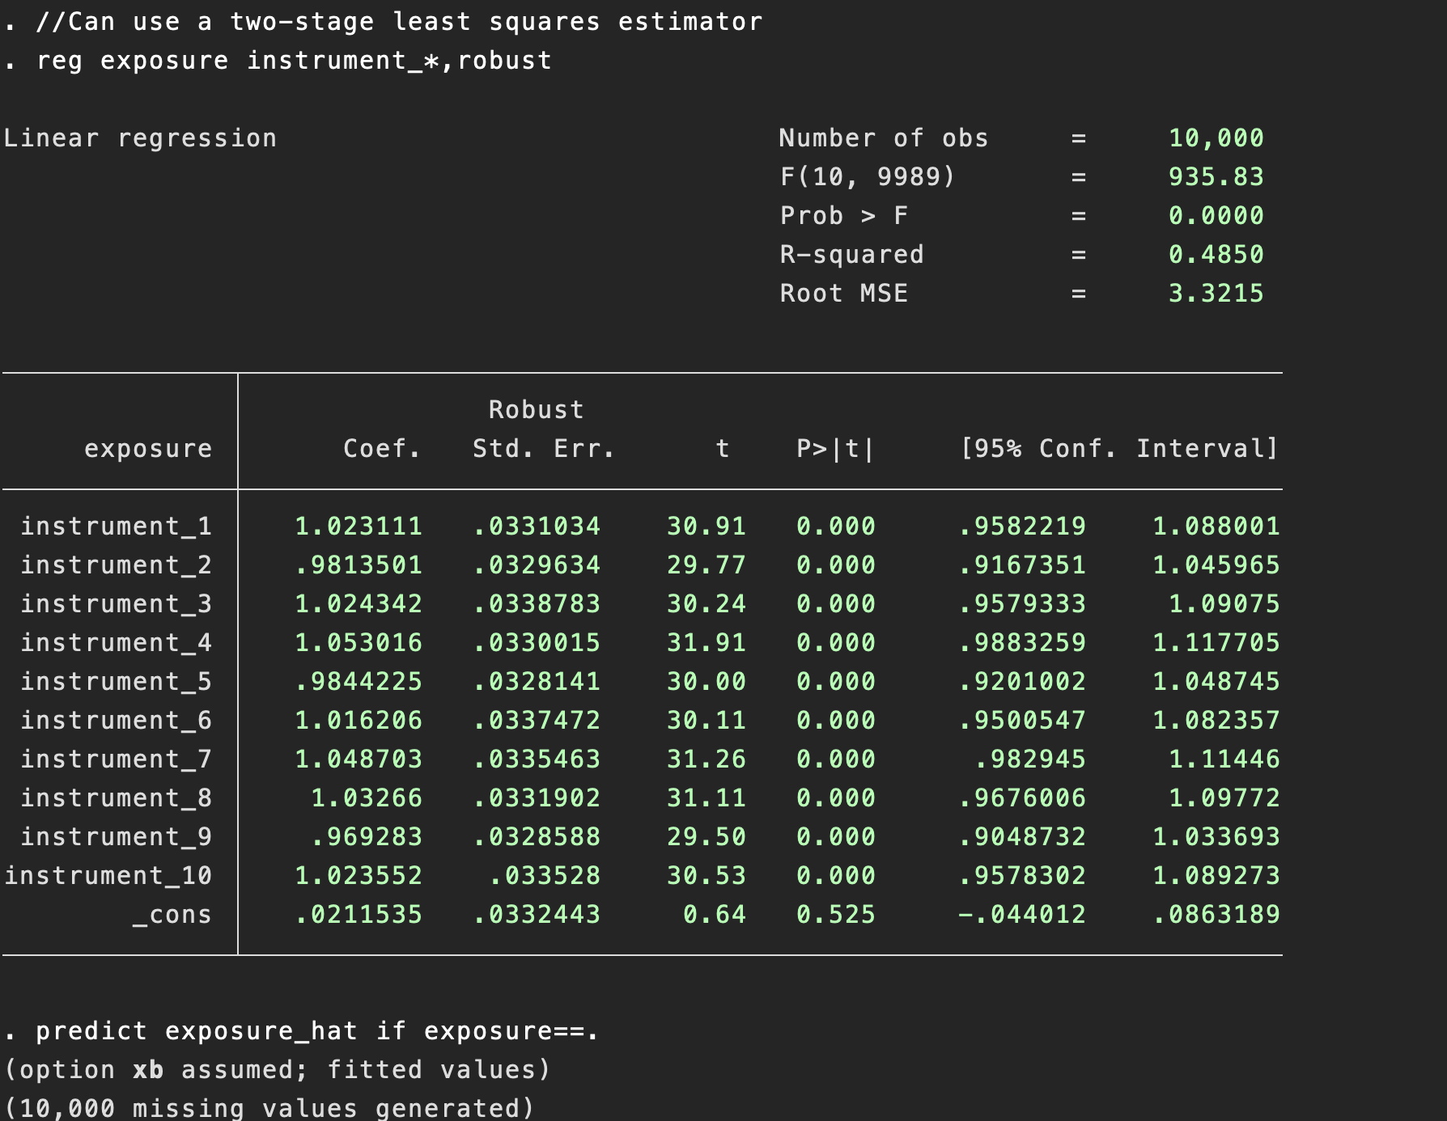
7. Two-sample estimators
Run the first stage regression in the 10k with exposure data.
Get predicted values of the exposure in the rest of sample
Estimate the association of the exposure in the entire sample

Slide 33
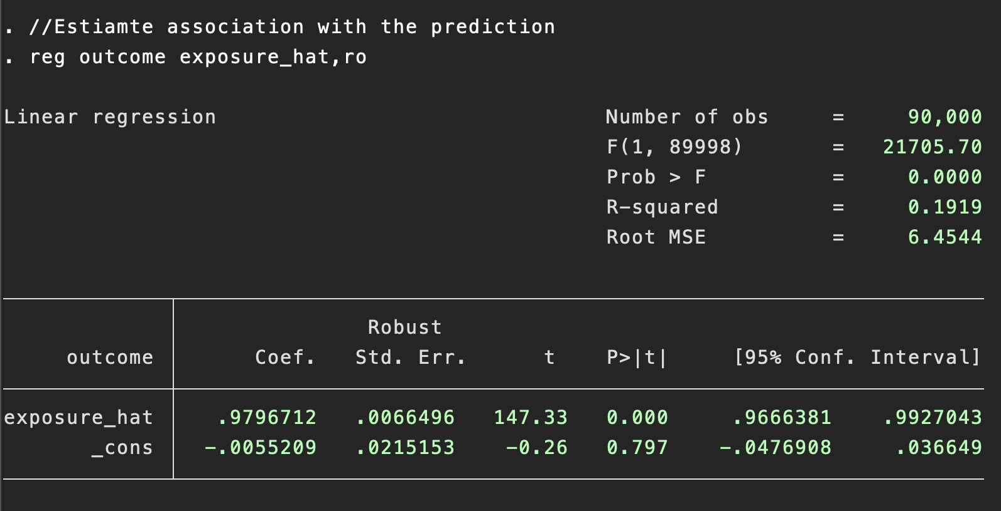
7. Two-sample estimators
More precise than using a single sample
SE=0.00665
SE reduced by 37%.
Possible to include entire sample.
Must account for estimation error as using same samples
Use bootstrapping as with 2SRI above.

Slide 34
8. Multivariate instrumental variables estimators
Can include multiple exposures in IV models
Need at least one IV per exposure
IV do not need to be independent
IVs explain sufficient conditional variation of all exposures
Can require massive sample sizes
Syntax is:

Slide 35
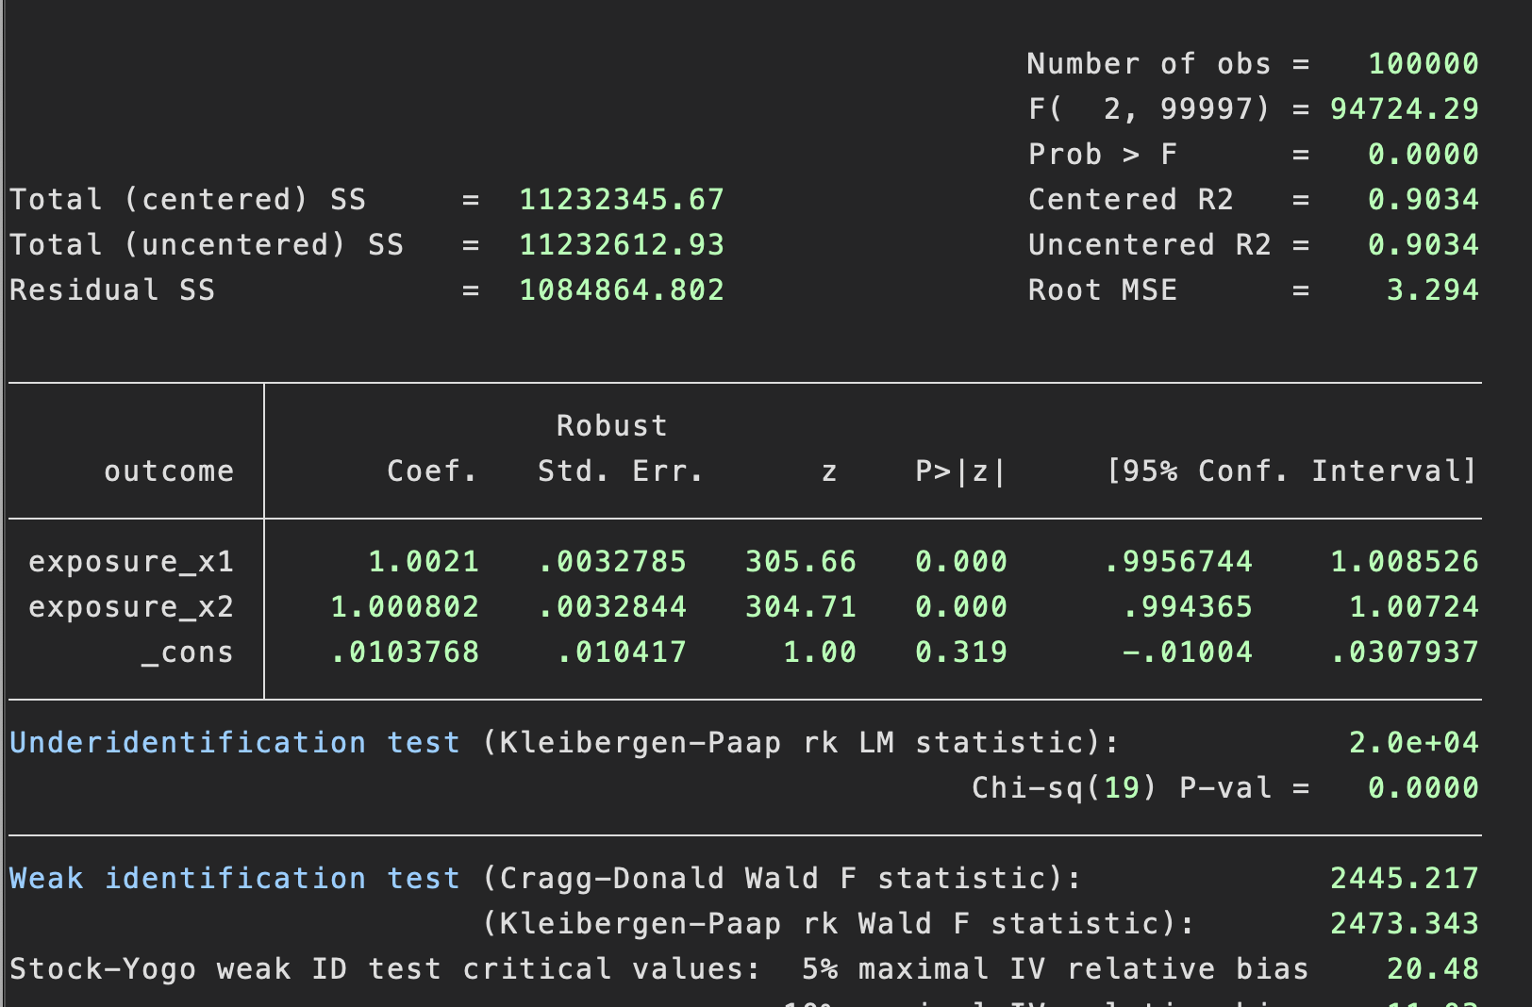
8. Multivariate instrumental variables estimators
Same interpretation as results with one exposure
Mean difference in outcome
Estimates the direct effect of each exposure
Identification tests indicate the joint significance of the instruments for all exposures
Use the Sanderson-Windmeijer F-test for multiple exposures

Slide 36
9. Covariates
Covariates can be included in IV analyses
E.g. time or age
Be careful not to control for downstream consequences of the exposure or a collider
Baseline covariates can increase efficiency of analyses
Can be an indication of issues if there are large differences in the point estimate before versus after adjustment
Use the same set of exposures in the first and second stage

Slide 37
9. Covariates: Fixed effects
Fixed effects estimators can be used with IV models
Either
Include dummy variables
Residualize
Use the xtivreg package
The first is simple, but can be computationally painful
Both other approaches normally fairly straight forwards
Be careful to account for clustering of data when estimating the standard errors.

Slide 38
Summary
Instrumental variable estimators include:
Reduced form (instrument-outcome association)
Continuous outcomes
Instrumental variable bounds
2 stage least squares/Wald estimator
Binary outcomes
Logistic SMM Causal odds-ratio
Multiplicative SMM Causal risk-ratio
Survival outcomes
Two-sample estimators
Multivariable instrumental variables estimators
Covariates

